Slide 1
General Tree Data Structure
Dr. Naveen Kumar
Associate Professor
Amity Institute of Information Technology
Amity University Patna

Slide 2
General Tree
A tree is an abstract data type that stores elements hierarchically.
Except for the top element, each element in a tree has a parent element and zero or more children elements. A tree is usually visualized by placing elements inside ovals or rectangles, and by drawing the connections between parents and children with straight lines.
General Tree (Each node can have arbitrary number of children) Level Order Traversal
Given a generic tree, perform a Level order traversal and print all of its nodes

Slide 3
A tree T as a set of nodes storing elements such that the nodes have a parent-child relationship that satisfies the following properties:
If T is nonempty, it has a special node, called the root of T , that has no parent.
Each node v of T different from the root has a unique parent node w; every node with parent w is a child of w.
Two nodes that are children of the same parent are siblings. A node v is external if v has no children. A node v is internal if it has one or more children. External nodes are also known as leaves.

Slide 4
Tree Abstract Data Type
A tree ADT using the concept of a position as an abstraction for a node of a tree. An element is stored at each position, and positions satisfy parent-child relationships that define the tree structure.
A position object for a tree supports the method:
getElement( ): Returns the element stored at this position.
The tree ADT then supports the following accessor methods, allowing a user to navigate the various positions of a tree T:
root( ): Returns the position of the root of the tree(or null if empty).
parent(p): Returns the position of the parent of position p (or null if p is the root).
children(p): Returns an iterable collection containing the children of position p (if any).
numChildren(p): Returns the number of children of position p.
If a tree T is ordered, then children(p) reports the children of p in order. In addition to the above fundamental accessor methods, a tree supports the following query methods:
isInternal(p): Returns true if position p has at least one child.
isExternal(p): Returns true if position p does not have any children.
isRoot(p): Returns true if position p is the root of the tree.

Slide 5
Trees support a number of more general methods, unrelated to the specific structure of the tree. These incude:
size( ): Returns the number of positions (and hence elements) that are contained in the tree.
isEmpty( ): Returns true if the tree does not contain any positions (and thus no elements).
iterator( ): Returns an iterator for all elements in the tree (so that the tree itself is Iterable).
positions( ): Returns an iterable collection of all positions of the tree.
If an invalid position is sent as a parameter to any method of a tree, then an IllegalArgumentException is thrown.

Slide 6
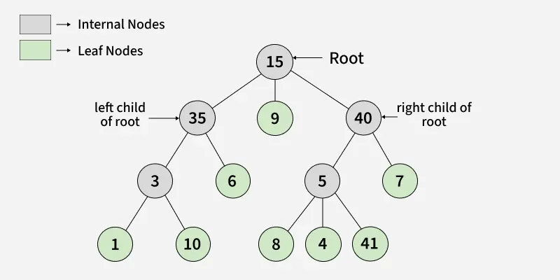
Internal (non-leaf) vs External (leaf) nodes
An internal node has at least one child, while an external node (also known as a leaf node) has no children.

Slide 7
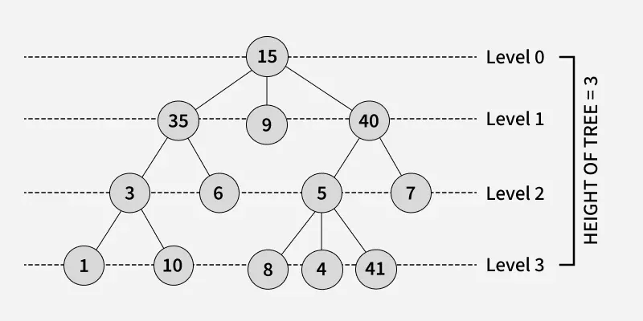
Height of Tree

Slide 8
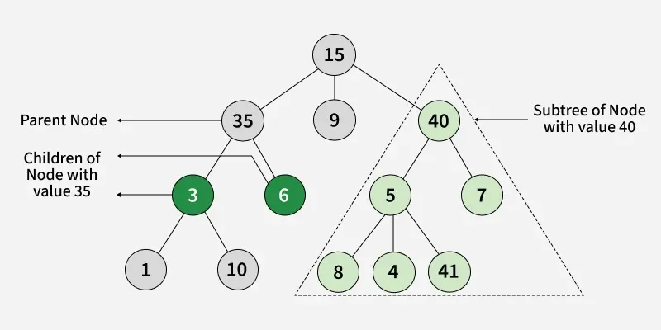

Slide 9
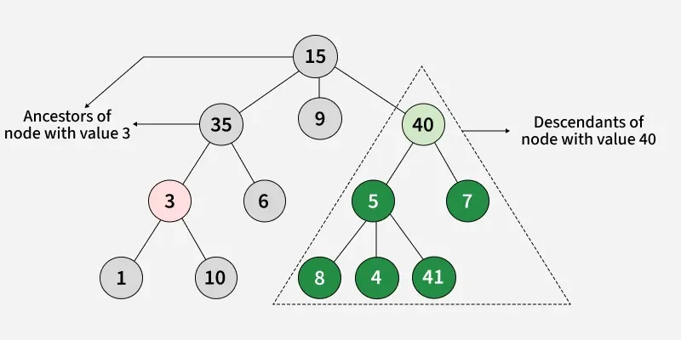

Slide 10
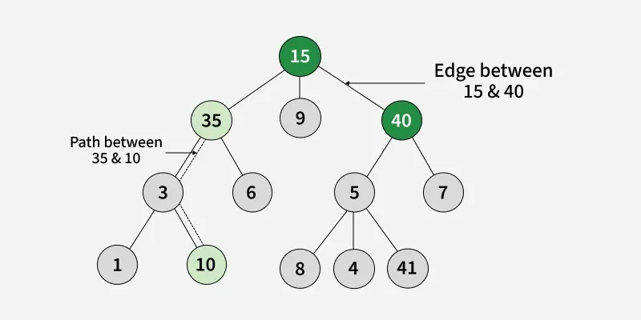

Slide 11
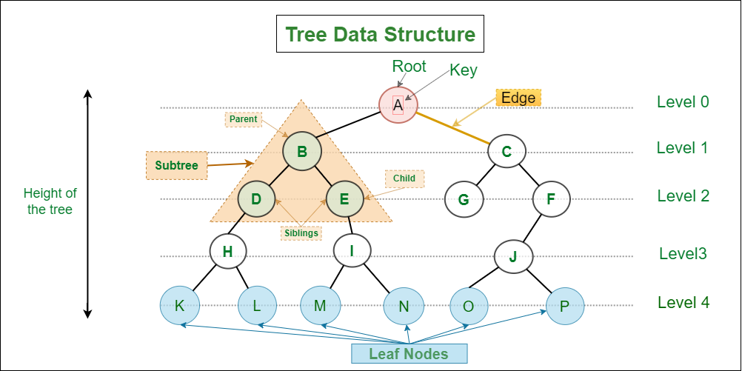

Slide 12
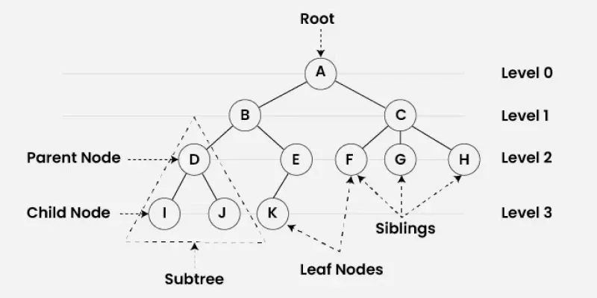

Slide 13
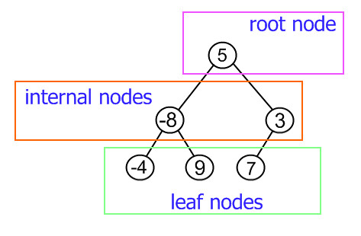

Slide 14
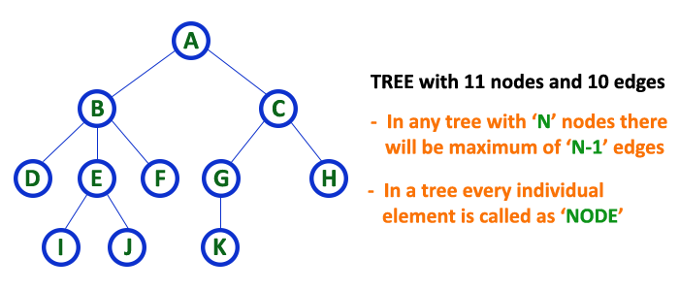

Slide 15
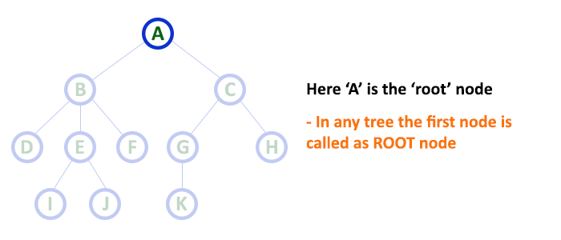
Root Node
In a tree data structure, the first node is called as Root Node. Every tree must have a root node. We can say that the root node is the origin of the tree data structure. In any tree, there must be only one root node. We never have multiple root nodes in a tree.

Slide 16
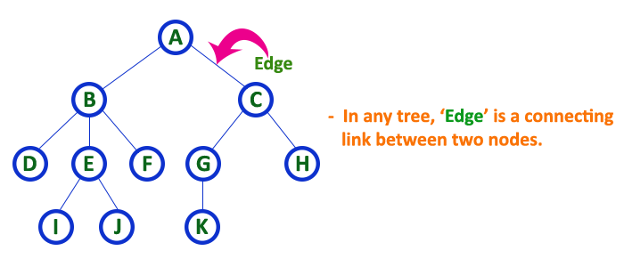
Edge
In a tree data structure, the connecting link between any two nodes is called as EDGE. In a tree with 'N' number of nodes there will be a maximum of 'N-1' number of edges.

Slide 17
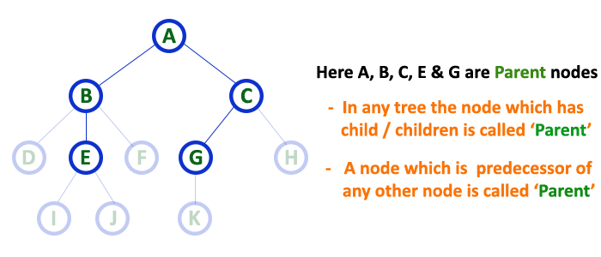
Parent
In a tree data structure, the node which is a predecessor of any node is called as PARENT NODE. In simple words, the node which has a branch from it to any other node is called a parent node. Parent node can also be defined as "The node which has child / children".

Slide 18
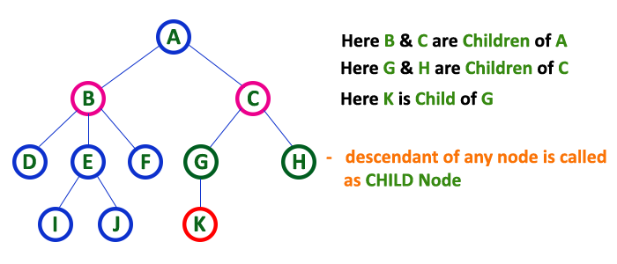
Child Node
In a tree data structure, the node which is descendant of any node is called as CHILD Node. In simple words, the node which has a link from its parent node is called as child node. In a tree, any parent node can have any number of child nodes. In a tree, all the nodes except root are child nodes.

Slide 19
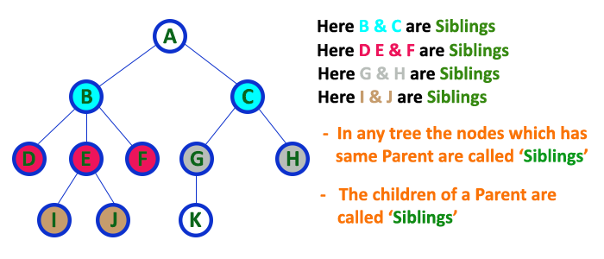
Sibling Nodes
In a tree data structure, nodes which belong to same Parent are called as SIBLINGS. In simple words, the nodes with the same parent are called Sibling nodes.

Slide 20
Leaf Nodes
In a tree data structure, the node which does not have a child is called as LEAF Node. In simple words, a leaf is a node with no child. In a tree data structure, the leaf nodes are also called as External Nodes. External node is also a node with no child. In a tree, leaf node is also called as 'Terminal' node.

Slide 21
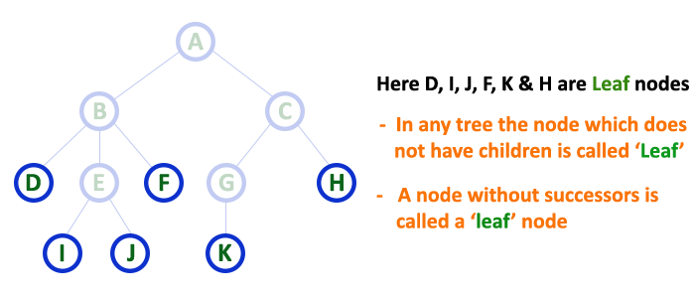

Slide 22
Internal Nodes
In a tree data structure, the node which has atleast one child is called as INTERNAL Node. In simple words, an internal node is a node with atleast one child. In a tree data structure, nodes other than leaf nodes are called as Internal Nodes. The root node is also said to be Internal Node if the tree has more than one node. Internal nodes are also called as 'Non-Terminal' nodes.

Slide 23
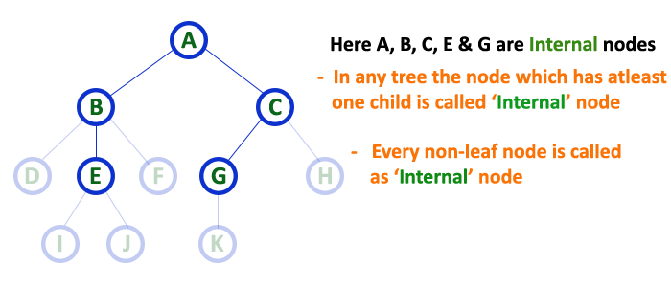

Slide 24
Degree on a Node
The total number of children of a node is called as DEGREE of that Node.
The highest degree of a node among all the nodes in a tree is called as 'Degree of Tree’.

Slide 25
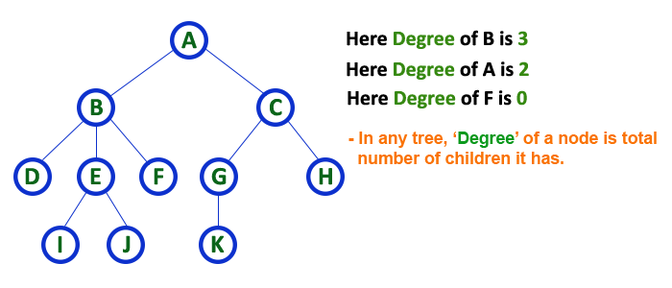

Slide 26
Level
The root node is said to be at Level 0 and the children of root node are at Level 1 and the children of the nodes which are at Level 1 will be at Level 2 and so on...
In a tree each step from top to bottom is called as a Level and the Level count starts with '0' and incremented by one at each level (Step).

Slide 27
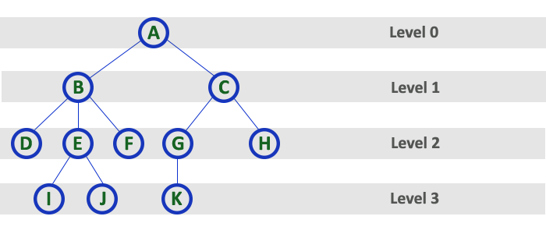

Slide 28
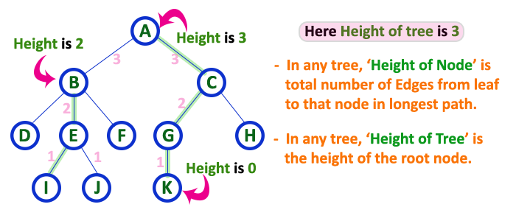
Height
The total number of edges from leaf node to a particular node in the longest path is called as HEIGHT of that Node. In a tree, height of the root node is said to be height of the tree. In a tree, height of all leaf nodes is '0'.

Slide 29
Depth
The total number of egdes from root node to a particular node is called as DEPTH of that Node.
The total number of edges from root node to a leaf node in the longest path is said to be Depth of the tree.
In simple words, the highest depth of any leaf node in a tree is said to be depth of that tree.
In a tree, depth of the root node is '0'.

Slide 30
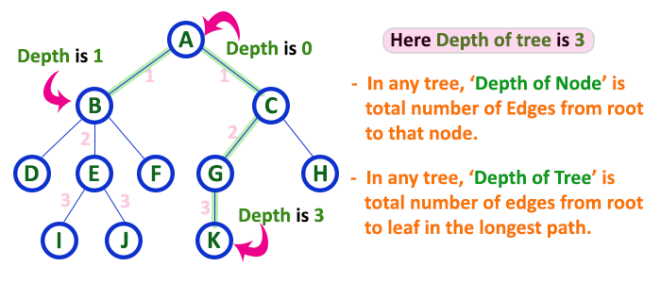

Slide 31
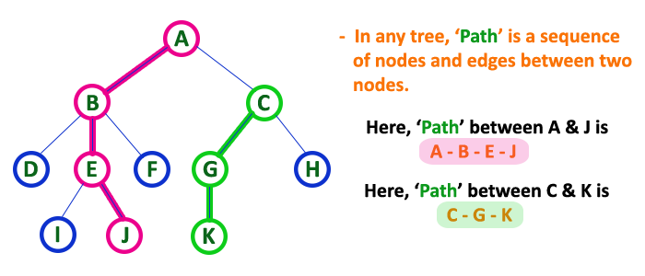
Path
The sequence of Nodes and Edges from one node to another node is called as PATH between that two Nodes. Length of a Path is total number of nodes in that path. In below example the path A - B - E - J has length 4.

Slide 32
Sub-Tree
In a tree data structure, each child from a node forms a subtree recursively. Every child node will form a subtree on its parent node.

Slide 33
Terminologies In Tree Data Structure:
Parent Node: A node that is an immediate predecessor of another node. Example: 35 is the parent of 3 and 6.
Child Node: A node that is an immediate successor of another node. Example: 3 and 6 are children of 35.
Root Node: The topmost node in a tree, which does not have a parent. Example: 15 is the root node.
Leaf Node (External Node): Nodes that do not have any children. Example: 1, 10, 12, 5, 7, 7 are leaf nodes.
Ancestor: Any node on the path from the root to a given node (excluding the node itself). Example: 15 and 35 are ancestors of 10.
Descendant: A node x is a descendant of another node y if y is an ancestor of x. Example: 1, 10, and 6 are descendants of 35.
Sibling: Nodes that share the same parent. Example: 1 and 10 are siblings, and 5 and 7 are siblings.
Level of a Node: The number of edges in the path from the root to that node.The root node is at level 0.
Internal Node: A node with at least one child.
Neighbor of a Node: The parent or children of a node.
Subtree: A node and all its descendants form a subtree.

Slide 34
Note in Tree
// Node structure for tree
class Node {
int data;
List<Node> children;
Node(int x) {
data = x;
children = new ArrayList<>();
}
}

Slide 35
Types of Tree Data Structures
Tree data structures can be classified based on the number of children each node can have.
Binary Tree:
Each node can have a maximum of two children.
Full Binary Tree – every node has either 0 or 2 children.
Complete Binary Tree – all levels are fully filled except possibly the last, which is filled from left to right.
Balanced Binary Tree – height difference between left and right subtrees of every node is minimal.
Ternary Tree:
Each node can have at most three children, often labeled as left, middle, and right.
N-ary Tree (or Generic Tree):
Each node can have any number of children.
Each node typically contains: Some data , A list of references to its children (duplicates are not allowed).
Unlike linked lists, nodes store references to multiple child nodes.

Slide 36
Basic Operations Of Tree Data Structure
Create – create a tree in the data structure.
Insert − Inserts data in a tree.
Search − Searches specific data in a tree to check whether it is present or not.
Traversal: Depth-First-Search Traversal Breadth-First-Search Traversal

Slide 37
Properties of Tree Data Structure:
Number of edges: An edge is the connection between two nodes. A tree with N nodes will always have N - 1 edges. There is exactly one path from any node to any other node in the tree.
Depth of a node: The depth of a node is the length of the path from the root to that node. Each edge in the path adds 1 unit to the length. Equivalently, it is the number of edges from the root to the node.
Height of the tree: The height of the tree is the length of the longest path from the root to any leaf node.
Degree of a node: The degree of a node is the number of subtrees attached to it (i.e., the number of children it has). A leaf node has a degree of 0. The degree of the tree is the maximum degree among all nodes in the tree.

Slide 38
General Applications
Hierarchical Structure: One reason to use trees might be because you want to store information that naturally forms a hierarchy. For example, the file system on a computer: The DOM model of an HTML page is also tree where we have html tag as root, head and body its children and these tags, then have their own children. DNS System is also example where we have natural hierarchy.
Searching Efficiency: Trees provide an efficient way to search for data. For example, in a binary search tree, searching for a value takes time proportional to the logarithm of the number of elements, which is much faster than searching in a linear data structure like an array or a linked list.
Sorting: Trees can be used to sort data efficiently. For example, in a self-balancing binary search tree, the data is automatically sorted as it is inserted into the tree, making it easy to find the minimum, maximum, and other values in the tree.
Dynamic Data: Trees are dynamic data structures, which means that they can grow and shrink as needed. This makes them well-suited for applications where the data changes frequently, such as in real-time systems.
Efficient Insertion and Deletion: Trees provide efficient algorithms for inserting and deleting data, which is important in many applications where data needs to be added or removed frequently.
Easy to Implement: Trees are relatively easy to implement, especially when compared to other data structures like graphs. This makes them a popular choice for many programming projects.

Slide 39
Other Applications of Tree Data Structure
Store hierarchical data, like folder structure, organization structure, XML/HTML data.
Binary Search Tree is a tree that allows fast search, insert, delete on a sorted data. It also allows finding closest item
Heap is a tree data structure which is implemented using arrays and used to implement priority queues.
B-Tree and B+ Tree : They are used to implement indexing in databases.
Syntax Tree: Scanning, parsing , generation of code and evaluation of arithmetic expressions in Compiler design.
K-D Tree: A space partitioning tree used to organize points in K dimensional space.
Trie : Used to implement dictionaries with prefix lookup.
Suffix Tree : For quick pattern searching in a fixed text.
Spanning Trees and shortest path trees are used in routers and bridges respectively in computer networks
As a workflow for compositing digital images for visual effects.
Decision trees.
Organization chart of a large organization.
In XML parser.

Slide 40
Other Applications of Tree Data Structure
Machine learning algorithm.
For indexing in database.
IN server like DNS (Domain Name Server)
In Computer Graphics.
To evaluate an expression.
In chess game to store defense moves of player.
In java virtual machine.
Tree data structures are used to organize and manage files and directories in a file system. Each file and directory is represented as a node in the tree, with parent-child relationships indicating the hierarchical structure of the file system.
Tree data structures are often used in parsing, such as in compilers and interpreters, to represent the structure of a program or a document.
Tree data structures, such as binary search trees, are commonly used to implement efficient searching and sorting algorithms.
Graphics and UI design
Tree data structures are commonly used in decision-making algorithms in artificial intelligence, such as game-playing algorithms, expert systems, and decision trees.
Tree data structures can be used to represent the topology of a network and to calculate routing tables for efficient data transmission.

